Slide 1
Modern Processors & Parallel Computing
Zhenbang You
2022/11/02

Slide 2


My Background
2018-2022
Bachelor of Science in Computer Science and Technology
2022-
Master of Science in Computer Science
Systems Track

Slide 3
“It is not a dreary science of paper machines that will never work. No! It’s a discipline of keen intellectual interest, requiring the balance of marketplace forces to cost-performance-power, leading to glorious failures and some notable successes.”
J. Hennessy, D. Patterson, Computer Architecture: A Quantitative Approach

Slide 4
Outline
Parallelism and programming model (from the perspective of implementation)
Instruction-Level Parallelism (ILP)
Data-Level Parallelism (DLP)
Thread-Level Parallelism (TLP)
Parallelism can also be categorized from a logical perspective
We will talk about this later
Performance of programming languages

Slide 5
Characteristics of the Lecture
Separation of abstraction and implementation
Try to give you clean programming models
Considering processors and memory at the same time
Performance = parallelism + locality

Slide 6
Before We Start
What is the source of parallelism?
Lack of dependencies!!!
We will keep realizing this in the lecture

Slide 7
Instruction-Level Parallelism (ILP)
Start from PIPE you learned in CSAPP
Why pipelining?
Why is it possible to do pipelining?
What are its advantages and disadvantages?
What is the next step to improve PIPE?

Slide 8
Instruction-Level Parallelism (ILP)
Start from PIPE you learned in CSAPP
Why pipelining?
Why is it possible to do pipelining?
The lack of dependencies among instructions
But dependencies still exist sometimes, thus we need forwarding and stall/bubble
What are its advantages and disadvantages?
More transistors for better performance
Complex, thus error-prone and expensive
What is the next step to improve PIPE?
A large number of books answering this question
One of the leading force that drove the improvement of processors in at least three decades

Slide 9
Instruction-Level Parallelism (ILP)
Instructions/sec = instructions/clock (IPC) * clocks/sec (frequency)
In the ILP-dominant era, the performance improvement mainly come from three kinds of force

Slide 10
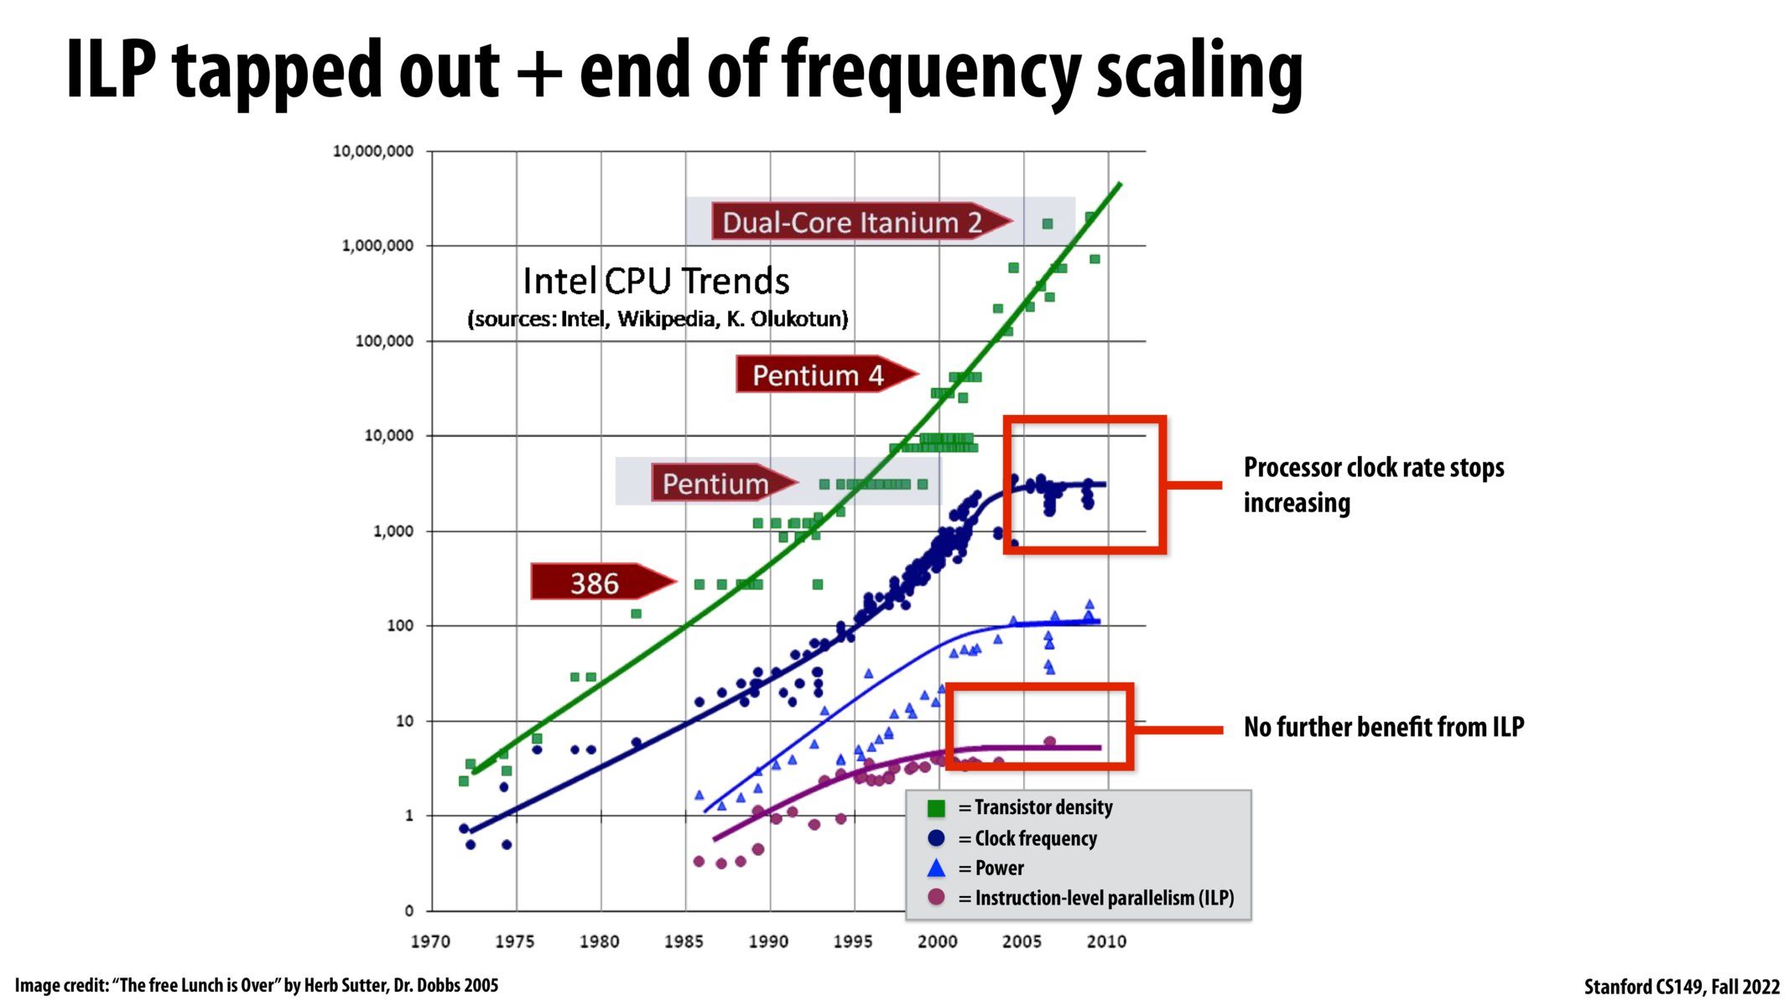

Slide 11
Instruction-Level Parallelism (ILP)
Instructions/sec = instructions/clock (IPC) * clocks/sec (frequency)
In the ILP-dominant era, the performance improvement mainly come from three kinds of force
Semiconductor manufacture technology
The latest: TSMC 5nm process
Hardware design
Compilers
Key takeaway: ILP is done by both hardware and compilers

Slide 12
Instruction-Level Parallelism (ILP)
What do programmers need to do?

Slide 13
Instruction-Level Parallelism (ILP)
What do programmers need to do?
Buy new hardware
“The more you buy, the more you safe.” ---- Jensen Huang
Install the latest compiler
Free ride!
Yes, it was the case.
But it ended in 2005

Slide 14
Instruction-Level Parallelism (ILP)
A little bit about implementation
Directed acyclic graph (DAG)
Vertex: one stage of an instruction
Edge: dependency between vertices
Example
Pipelining, deeper pipeline (more vertices, less dependencies)
Superscalar execution, multiple issue
Out-of-order execution (dynamic scheduling, hardware) & instruction scheduling (static scheduling, compiler)
Register renaming
Branch prediction

Slide 15
Limitations of ILP
Three walls
Memory wall
Latency is the key bottleneck
Latency vs bandwidth
Power wall
Especially for low-end devices and devices emphasizing power-efficiency
ILP wall
Potential ILP it limited

Slide 16
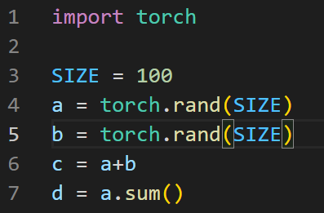
Data-Level Parallelism (DLP)
Programming model/data-parallel thinking
Vectorization/Single Instruction Multiple Data (SIMD)
Organize computation as operations on vectors
Example
PyTorch:

Slide 17
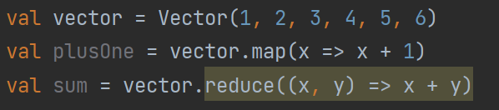
Data-Level Parallelism (DLP)
Another example
Scala
Functional programming: map, reduce
Compared to PyTorch:
“c = a + b” corresponds to “map” (element-wise operation)
Can be done in constant time given enough processors
“d = a.sum()” corresponds to “reduce” (reducing a vector into a scalar)
Can be done in logarithmic time given enough processors
Scales to distributed systems (beyond a single machine)
Simple as it seems, it is indeed extremely powerful!
We will see other programming platforms for DLP share the same programming model

Slide 18
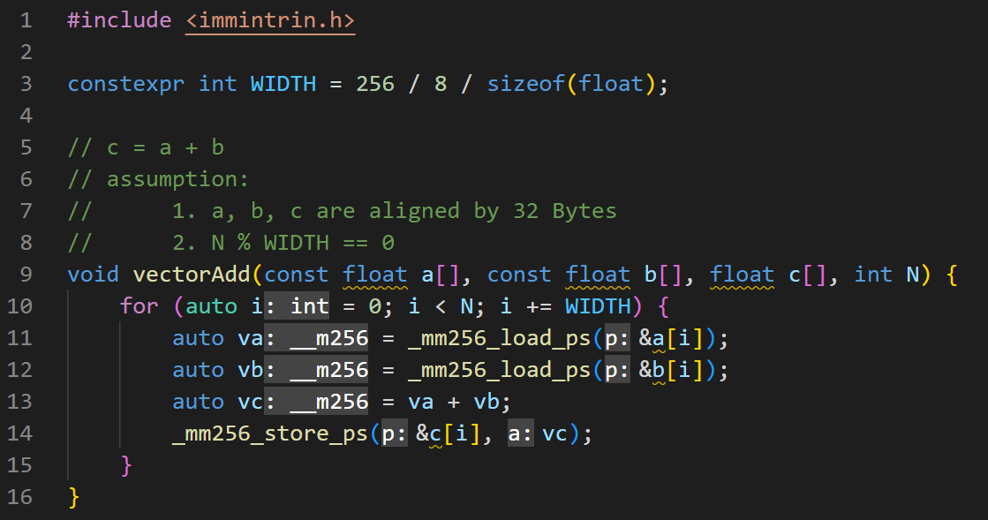
Data-Level Parallelism (DLP)
Example: x86 AVX intrinsics
Platform-dependent
Add (map operation)
__m256 contains float * 8

Slide 19
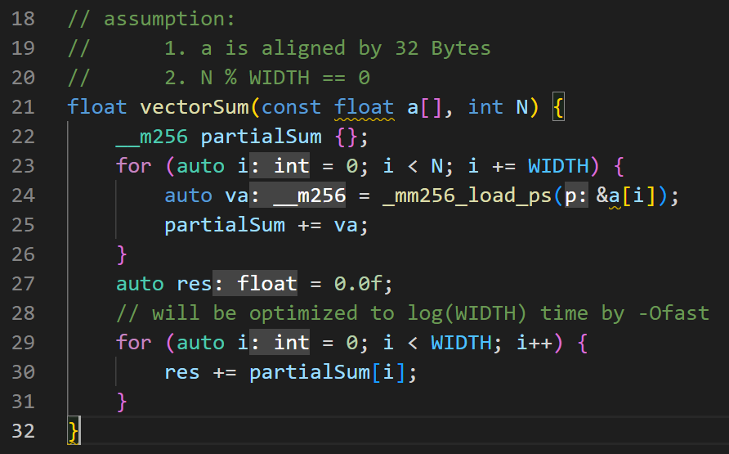
Data-Level Parallelism (DLP)
Example: x86 AVX intrinsics
Sum (reduce operation)
Ignoring non-associativity of float

Slide 20
Data-Level Parallelism (DLP)
Where does the potential of DLP comes?
ILP: lack of dependencies among instructions
DLP: lack of dependencies among (____)

Slide 21
Data-Level Parallelism (DLP)
Where does the potential of DLP comes?
ILP: lack of dependencies among instructions
DLP: lack of dependencies among elements

Slide 22
Data-Level Parallelism (DLP)
Implementation (three categories)
Common feature: one instruction operates on multiple data
CPU (requires extra hardware units)
Deeper
More pipeline stages to achieve higher frequency
Vector architecture
E.g., RISC-V vector extension, ARM Neon
Reviving!
Wider
Wider registers, wider ALU, …
Multimedia SIMD extension
E.g., AVX (AVX/AVX allows 32bit*8 or 64bit*4)
Programmed by intrinsics, platform-dependent but largely the same

Slide 23
Data-Level Parallelism (DLP)
Implementation (three categories)
CPU
Disadvantages
Power-hungry
AVX512 is extremely power hungry
Static power is always there no matter whether you use it
Intel efficient cores (little cores) do not support AVX512
Transistor count
Costly for context switch
In real systems, you need to save/restore registers on a routinely basis
You will learn this in chap 8
Vector architecture is much more complex than AVX

Slide 24
Data-Level Parallelism (DLP)
Implementation
GPU
Usage
Graphics
Scientific computing
Deep learning
Cryptocurrency mining
Multiple SIMD processors
Very simple pipeline
Low frequency (1-2.5GHz vs 3-6GHz of CPU)
Each core is much less powerful than that of CPU
But GPU has lots of cores!
AMD 5990X: 64 cores, NVIDIA 4090: 16384 cores
Programmed by CUDA (NVIDIA) and OpenCL (others)

Slide 25
Data-Level Parallelism (DLP)
GPU
Requirements for memory
Bandwidth instead of latency
GDDR, HBM
GDDR vs DDR
Bandwidth vs latency
HBM: the future, high bandwidth, low latency, still expensive

Slide 26
Data-Level Parallelism (DLP)
Memory bandwidth comparison
Typical PC CPU
DDR4-3200, 2 channels: 3200 MHz * 8 B * 2 channels = 51.2 GB/s
DDR5-4800, 2 channels: 4800 MHz * 8 B * 2 channels = 76.8 GB/s
Extremal server CPU
DDR5-6400, 8 channels: 6400 MHz * 8 B * 8 channels = 409.6 GB/s
Beyond current technologies
PC GPU
NVIDIA 4090: 1,008GB/s
NVIDIA 3060: 360GB/s
Enterprise-level GPU
NVIDIA H100 SXM5: 1,920 GB/s
Apple M-series
M1 Max: 400 GB/s
Memory bandwidth can sometimes be one of the key factors contributing to the huge performance gap between CPU and GPU

Slide 27
Data-Level Parallelism (DLP)
GPU
Disadvantages
Transferring data between main memory and VRAM (GPU memory): high latency, low bandwidth

Slide 28
Data-Level Parallelism (DLP)
Most scalable
Most efficient
Cost-efficient, power-efficient
Cost-power-performance
As long as you have enough DLP

Slide 29
Thread-Level Parallelism (TLP)
2005: the advent of multi-core CPU
Sun UltraSPARC T1
4/6/8 cores, 4 threads/core
The first practical multicore processor
One of my instructors of CS149, Kunle Olukotun, was one of its architects
AMD Athlon 64 X2
2 cores
Lack of dependencies among what?

Slide 30
Thread-Level Parallelism (TLP)
2005: the advent of multi-core CPU
Sun UltraSPARC T1
4/6/8 cores, 4 threads/core
The first practical multicore processor
One of my instructors of CS149, Kunle Olukotun, was one of its architects
AMD Athlon 64 X2
2 cores
Lack of dependencies among what?
Tasks!

Slide 31
Thread-Level Parallelism (TLP)
Multiple Instructions Multiple Data (MIMD)
MIMD vs SIMD
Flexibility
Task parallel vs data parallel
Two kinds of logical parallelism that application programmers care about
Heterogenous vs homogenous
Efficiency
Scalability

Slide 32
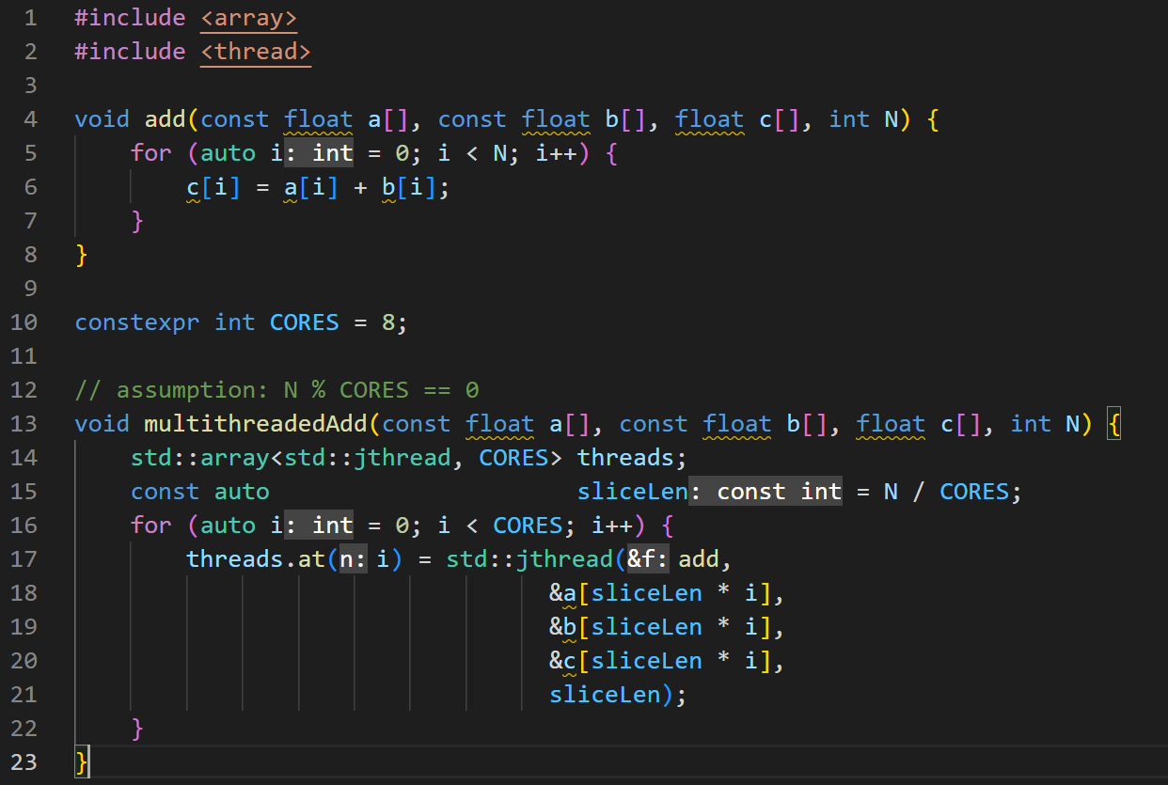
Thread-Level Parallelism (TLP)
C++20: std::jthread
Fork-join
Sum can be implemented in the same style. Try it yourself.
You will find how hard it is to program in pthread two months later

Slide 33
Thread-Level Parallelism (TLP)
You will learn how to programming multiple threads in Chapter 12
But the programming interfaces introduced in CSAPP are hard to use
Recommend:
C++: std:: thread, std::jthread, std::future
Java: thread, future
Go: goroutine
Scala/Haskell: Future

Slide 34
Thread-Level Parallelism (TLP)
Multiple cores
Cache
Cache coherence & memory consistency
No plan to talk about this in the lecture
Multithreading
Heterogeneous cores
E.g., ARM big-LITTLE, intel performance cores & efficient cores

Slide 35
Thread-Level Parallelism (TLP)
Less larger cores vs more smaller cores
Varying among different scenarios
For PC gamers, prefer less larger cores
For cloud service provider, prefer more smaller cores
AMD c series, e.g., ZEN4c, 128 small cores
AWS designs its own processors to achieve better power efficiency

Slide 36
Thread-Level Parallelism (TLP)
Limitations
Scalability
Why don’t we have more cores?
Communication
Coherence
Yield
Chiplet
Amdahl’s Law
How much you can improve depends on how much you can’t improve
There is always code that can’t be parallelized

Slide 37
Thread-Level Parallelism (TLP)
Memory requirements
Latency: ILP > TLP > DLP
Bandwidth: DLP > TLP > ILP

Slide 38
The era of cloud computing
If we can assemble computation from the crowd, there may be more parallelism we can use
This is called Request-Level Parallelism (RLP)
Loosely coupled task parallelism
This is the key argument of cloud computing
Very hot topic, both in the industry and in the academia

Slide 39
Computation hierarchy
Computation hierarchy
Core -> processor > cluster
ILP -> DLP -> TLP -> RLP
Memory hierarchy
Register -> per-core cache -> shared cache -> memory -> disk -> remote storage

Slide 40
The Era of Domain-Specific Architecture (DSA)
DSA typically exploits different kinds of parallelisms in certain scenarios
Wait, this should require lots of domain-specific languages (DSL)!
But there aren’t too many kinds of parallelisms and programming models
Personally speaking, I think it’s the key to why DSA may make a difference in the future
Compilers play a key role
CPU and GPU only occupy 1/3 die size in your smartphone processor
Very hot topic in the academia, but its industrial potential is still to be seen

Slide 41
Performance of Programming Languages
A few words before starting
The performance of a program highly depends on code quality, and thus highly depends on the time you spend
Development of C++ is very slow and error-prone. You may obtain a highly optimized Java program outperforming an equivalent one in C++ with the same time.
If a program it not computation-intensive (spending most of the time on things other than computation, like disk I/O and network I/O), then the performance of programming languages will play a less important role
Performance of a programming languages depends on both the interface (language specifications) and the implementation (compiler and libraries)
Benchmark, benchmark, benchmark!

Slide 42
Performance of Programming Languages
C/C++ is performant, but how about others?
The performance of Python is insane!!!
I really don’t like Python. I can discuss this when having a chance
Why is Python slow?

Slide 43
Performance of Programming Languages
Just-in-Time compilation (JIT)
C: source code -> native assembly code
Java: two stages
Compile time: Source code -> Java Bytecode
Runtime: Java Bytecode is interpreted by Java Virtual Machine (JVM)
JVM compiles hotspot code into native code to boost performance
More statistics for optimization, e.g., branch prediction
James Gosling: Java will be slower if it is compiled ahead of time (AOT)

Slide 44
Performance of Programming Languages
Is there modern languages with similar performance to C/C++?

Slide 45
Performance of Programming Languages
Is there modern languages with similar performance to C/C++?
Rust!
Reasonable languages typically run in no more than 3X time of C on average, including
JavaScript: Garbage collection, dynamic type
Go: conservative compiler optimization
Enough to develop OS
OCaml: functional language
Indeed, it is very efficient. No more than 2X of C

Slide 46
Performance of Programming Languages
It always arouses controversy to compare programming languages…

Slide 47
After ICS
Two perspectives of learning computer architecture
User: parallel computing
Builder: hardware design
Functional programming helps a lot for learning parallel computing
OS knowledge required for understanding multithreading
Network and databases knowledge required to understand distributed computing
Systems courses of PKU are generally too shallow and require too little coding

Slide 48
Computer Systems Learning Resources: A Recommended List
Written in Jan 2022, still updating
Covering most of the major fields in computer systems
Contains lots of textbooks, courses, online documentations, and abundant guidelines
Latest version website
https://www.overleaf.com/read/txqjnjxyxqqx
GitHub address
https://github.com/ZhenbangYou/Computer-Systems-Learning-Resources-A-Recommended-List

Slide 49
If you want to chat with me …
WeChat
Email: zhenbangyou@pku.edu.cn

Slide 50
Acknowledgements
My friends (unordered)
Zirui Ou
Zeang Sheng
Yunqi Li
Yinmin Zhong
Tingyu Zhu
Tianchi Li
All my friends in ICS Seminar 1 in 2021 fall
Course
Stanford CS149 and its instructors
Books
Computer Architecture: A Quantitative Approach (6th Edition)

